Slide 1

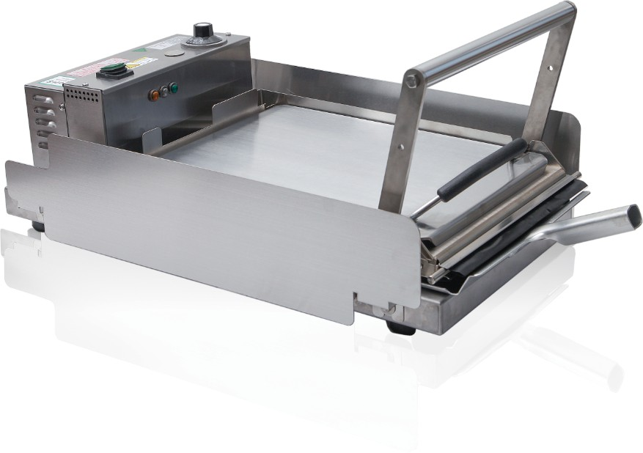
Knight Toaster
BT-SGM
Specification Guide
FEATURES
Batch Toasting
Toast 12 pairs of 4-inch bun each time.
Flexibly Control Temperature & Time
The toasting temperature and time can be freely adjusted according to the different type of bun to achieve golden caramelization.
Even Toasting Temperature
Double-layered nickel-plated aluminum heating plates ensure more uniform heating. When baking is finished, an indicator light will turn on, accompanied by an audible alert.
Easy to Clean & Worry-Free Maintenance
Comes with Teflon paper to prevent sticking; dual-winged side panels can be rotated for easy cleaning and maintenance.
5 Different Compression Adjustments
The heating platen height can be manually adjusted to ensure that various size buns can be toasted with the best result.
Longer Machine Lifespan
Customized for frequent commercial use, equipped with high-temperature protection.

Slide 2
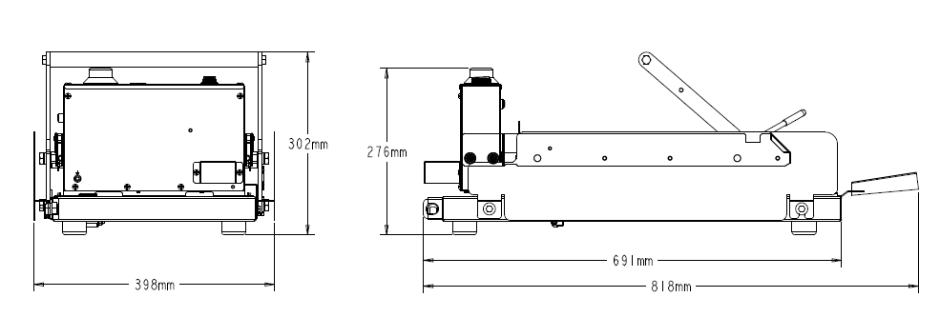
Knight Toaster
BT-SGM
Specification Guide
Technical Specifications
Model Number | BT-SGM
Product Category | Knight Toaster
Product Dimension | W398mm x H275mm x D81mm (open）
Electric Parameter | Voltage：220VAC Frequency：50Hz Power：2300W
Shipping Weight | 32kg
Heating Plate | Aluminum alloy A356, nickel-plated
Warranty | One year
Agency Listing | GB
For details about the materials required for installation, please refer to the Installation Manual.
©2023 Cornelius (Tianjin) Co., Ltd. TJ2023.M023001-SP.1

